Slide 1



General Software Development
The process of creating software
SoftUni Team
Technical Trainers
Software University
http://softuni.bg

Slide 2

Table of Contents
The Application Lifecycle Management (ALM):
Requirements analysis
Design process
Software Development
Software Testing
Release Management

Slide 3

Application Lifecycle Management

Slide 4
Application Lifecycle Management
Application lifecycle management (ALM) is the set of activities that revolve around a new software product
Those activities stay from the project’s inception to when the product matures and perhaps retires
Requirements
Design
Development
Testing
Maintenance

Slide 5

Application Lifecycle Management
An application’s lifecycle is much like a human’s life
Begins with an idea
Once created, the next big event is its deployment, when it goes into production
When the application no longer has business value, it reaches its end of life and is removed from service

Slide 6
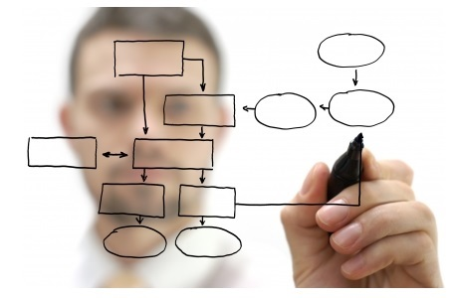
Requirements Analysis

Slide 7
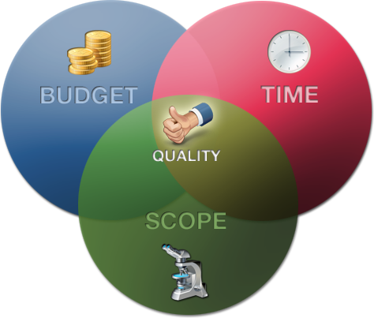
Requirements Analysis
Requirements analysis is the process of determining the detailed business requirements for a new software system
one of the most important steps in the application lifecycle
Precise, complete, well-documented requirements are critical to the success of the project

Slide 8
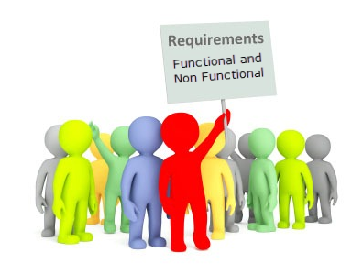
Requirements Analysis
The requirements can be functional or nonfunctional
Functional requirements specify exactly what the system is designed to accomplish
In contrast, nonfunctional requirements are quality requirements such as scalability, security, reliability, and so on

Slide 9
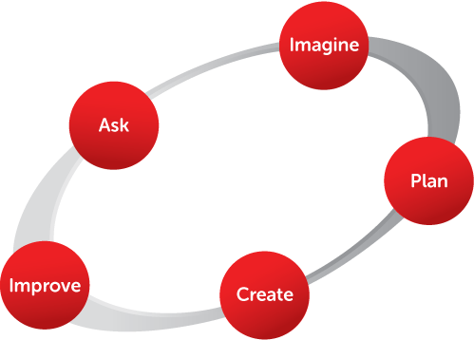
Design Process

Slide 10
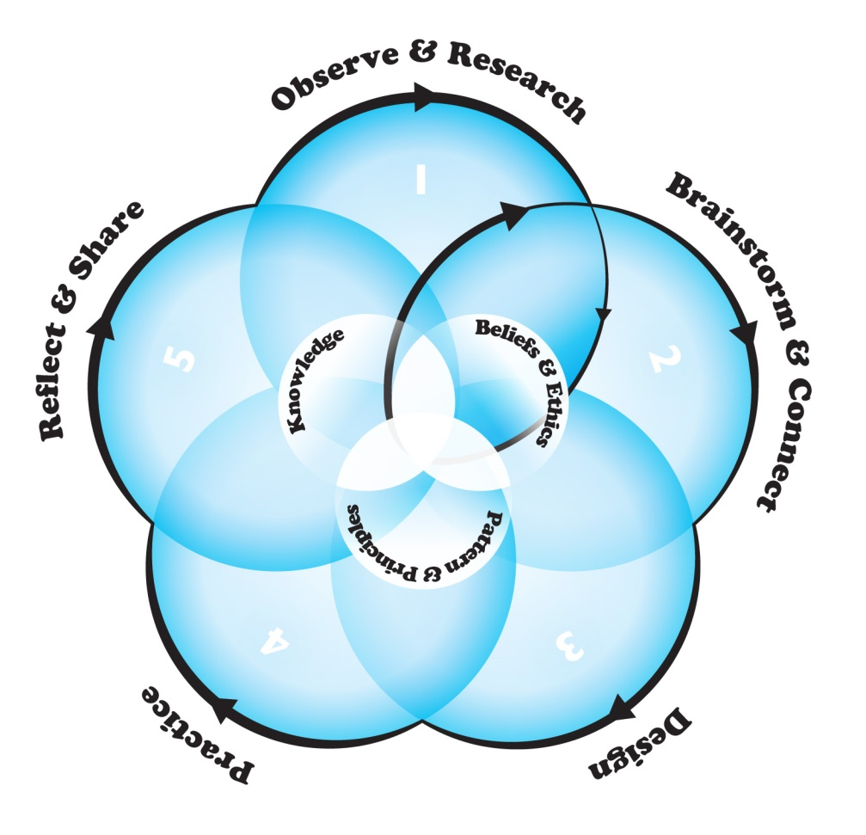
Design Process
The design process, for a particular software is the process of creating plans, models, and architecture for the product’s implementation
The result of the design process is a set of technical models and detailed specifications

Slide 11

Design Process
Some of the most important participants in the design process:
The Architect
Designs the technical blueprint of the system.
The User-experience Designer
Designs the user interface elements and the navigation between them

Slide 12

Software Development

Slide 13

Software Development
The software development is that part of the ALM where all the ideas and business requirements are implemented into code
At the end of the software development phase you have a finished software product with which users can interact

Slide 14
Software Development
The critical participants in the software development include:
Developers
Write code based on the gathered requirements and designed models
Database Administrators
Responsible for creating and maintaining of the software’s databases
Technical writers
Develop the system manuals and instruction files.
Content Developers
Subject matter experts who develop the content for the system

Slide 15

Software Testing

Slide 16

Design Process
Software testing is the process of verifying if the implementation of the software matches the requirements of the system
Software testing is used to assure the quality of the final product
The process of designing tests early in the life cycle can help to prevent defects from being introduced in the code

Slide 17

Release Management

Slide 18

Release Management
Release management is the process of managing, planning, scheduling and controlling a software build through different stages and environments; including testing and deploying software releases
Includes activities such as:
packaging and deploying the software
managing software defects
managing software change requests

Slide 19
Release Management
Major figures in the release management activity:
Release Manager
ensures timely release of a software product by coordinating various teams and business units
Operation Staff
Ensures the delivery of the system is successful and as promised
Technical Support Staff
Interacts with customers and helps solving their problems with the system

Slide 20

Summary
What is the Application Lifecycle Management?
What are the main phases of the ALM?
What is the main purpose of each one?
Why are they necessary?
Who are the core figures in each of those phases?
What is their main responsibility?

Slide 21








Questions
https://softuni.bg/courses/javascript-applications/

